Slide 1
A. NEUROBIOLOGY REFRESHER
This refresher distills the minimum neurobiology needed to understand the modeling concepts discussed in the chapter. Learners first revisit the semi‑permeable membrane and ion selectivity, then link Nernst (equilibrium) potentials to reversal potentials to explain the sign and magnitude of synaptic currents. From there, the membrane as an RC low‑pass filter motivates the time constant (τ) and step/impulse responses; a single dendritic cable introduces electrotonic distance (λ) and explains why otherwise identical synapses exert different somatic leverage purely by location. The refresher closes with a qualitative view of spike generation (threshold, refractoriness) and a first look at E/I timing motifs (e.g., feedforward inhibition) that will reappear in circuit models.
To support active reading, the refresher provides guided prompts for locating one or two high‑quality “explainers” per concept (e.g., Nernst intuition, τ animations, cable attenuation). It also includes micro‑checks that ask students to predict current sign from E_rev and V_m, reason about how changing [K⁺]_out shifts E_K, and connect larger τ to EPSP shape and coincidence detection. These brief items bridge directly to the modeling work: the same variables (E_rev, τ, λ) become adjustable knobs in Set B, reappear in passive vs. active analyses in Sets C–E, scaffold network dynamics in Set F, and ground mechanistic interpretations of behavior in Set G and device outputs in Set H. The refresher provides a compact vocabulary so students can recognize and reuse core state variables and readouts across all level, from membrane to behavior.
Getting started: Click on the following link - Colab_A and complete the sequentially arranged hand-on learning - generating AI prompts for explanations and complete the exercises at the end.
A set of slides are provided to get started - the learner is encouraged to add more as appropriate.

Slide 2
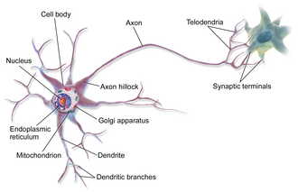
BIOLOGICAL STRUCTURE OF A NEURON
A1. What Is a Neuron? — A Biological Cell With Special Morphology A neuron is a single eukaryotic cell with a nucleus, cytoplasm, organelles
and a plasma membrane. Specialized morphology – compact soma with long
processes for long‑distance communication and complex connectivity.
Self‑learning prompt: “Explain the biological structure and functions of
soma, dendrites, and axon. Include cytoskeleton roles (microtubules, actin,
neurofilaments) and intracellular transport (kinesin/dynein) in everyday
neuronal maintenance—no electrophysiology.”
A2. The Three Major Regions for signaling - Soma, Dendrites, Axon
Soma: Houses the nucleus and core biosynthetic machinery.
Dendrites: Branched extensions that receive inputs at synapses.
Axon: Long projection that delivers outputs to targets at terminals.
Self‑learning prompt: Now describe the neuron in terms of the
Function of communication. List the key components involved in
electrical communication, and their roles.
A3. Simplifying the Soma - Treating It as a Sphere For introductory reasoning, we often approximate the soma as a sphere. Real somas vary by cell type, but the spherical simplification helps keep attention on membrane and internal/external composition before adding complexity.
Self‑learning prompt: Explain when and why biologists approximate the soma as spherical. Give two benefits and two limitations of this simplification in early learning (e.g., area/volume intuition, ignoring irregular surfaces).
Tone

Slide 3
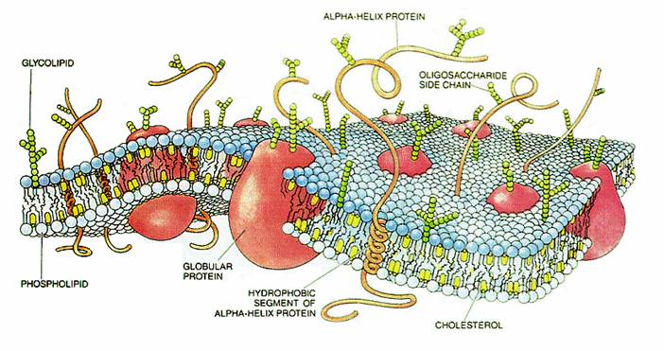
A4. The Cell Membrane — Phospholipid Bilayer (Structure Only) The neuronal plasma membrane is a phospholipid bilayer that forms a semi‑permeable boundary. Integral and peripheral proteins are embedded or associated
with it, enabling selective interaction with the environment.
Self‑learning prompt: Describe neuronal plasma membrane
as a biological structure in detail without electrical terms.
A5. Membrane Proteins - Channels, Pumps, Transporters,
Receptors – what are they?
Ion channels: Protein pores selective for specific ions.
Pumps (ATPases): Use ATP to move ions against gradients.
Transporters/Exchangers: Use gradients (secondary active transport).
Receptors: Bind ligands (e.g., neurotransmitters) to trigger cellular responses.
Self‑learning prompt: List ion channels, pumps, transporters/exchangers, and receptors. For each, give a 1–2 sentence biological role and an example subtype (e.g., Na⁺/K⁺‑ATPase, glutamate transporter, ligand‑gated receptor). Avoid any circuit discussion.
A6. Biologically Important Ions — Inside vs Outside Typical asymmetries: intracellular K⁺ high; extracellular Na⁺ and Cl⁻ high; intracellular free Ca²⁺ extremely low (nanomolar to low micromolar).
Self‑learning prompt: Summarize where Na⁺, K⁺, Cl⁻, and Ca²⁺ are most abundant (inside vs outside). Explain, in biological terms, why cells maintain these distributions (homeostasis, signaling readiness), without referring to voltage.

Slide 4
A7. Concentration Gradients — Homeostatic Property of Cells
Cells invest energy (directly or indirectly) to maintain stable concentration gradients that support metabolism, osmotic balance, signaling capacity, and protein function.
Self‑learning prompt: Explain how pumps and transporters maintain ion gradients. Include ATP dependence for primary active transport and gradient‑driven secondary transport, using two concrete examples.
A8. Ion Pumps & Transporters — ATP‑Dependent Maintenance The Na⁺/K⁺‑ATPase exports 3 Na⁺ and imports 2 K⁺ per ATP, helping stabilize intracellular composition. Other transporters regulate Ca²⁺ and Cl⁻ to maintain cellular viability and signaling readiness.
Self‑learning prompt: Describe the Na⁺/K⁺‑ATPase cycle in words. Then outline one Ca²⁺ handling mechanism (e.g., SERCA pump or NCX exchanger) and its biological purpose.
A9. Ion Channels — Open vs Closed Conformations (Structure and Gating Cues)
Channels switch between closed and open states via protein conformational changes. Triggers can include ligand binding, stretch, intracellular signals, or membrane voltage (we postpone electrical roles until later).
Self‑learning prompt: Describe the concept of channel gating as protein conformational change. Give one example each of a ligand‑gated, mechanically gated, and voltage‑sensitive channel—biological roles only.
A10. Diffusion — Natural Molecular Motion Diffusion arises from random thermal motion. When a gradient exists, there is net movement down the gradient until balance is approached, modulated by permeability and barriers.
Self‑learning prompt: In biological language, define diffusion and permeability. Explain how membrane composition and protein pores influence effective diffusion of ions or molecules.

Slide 5
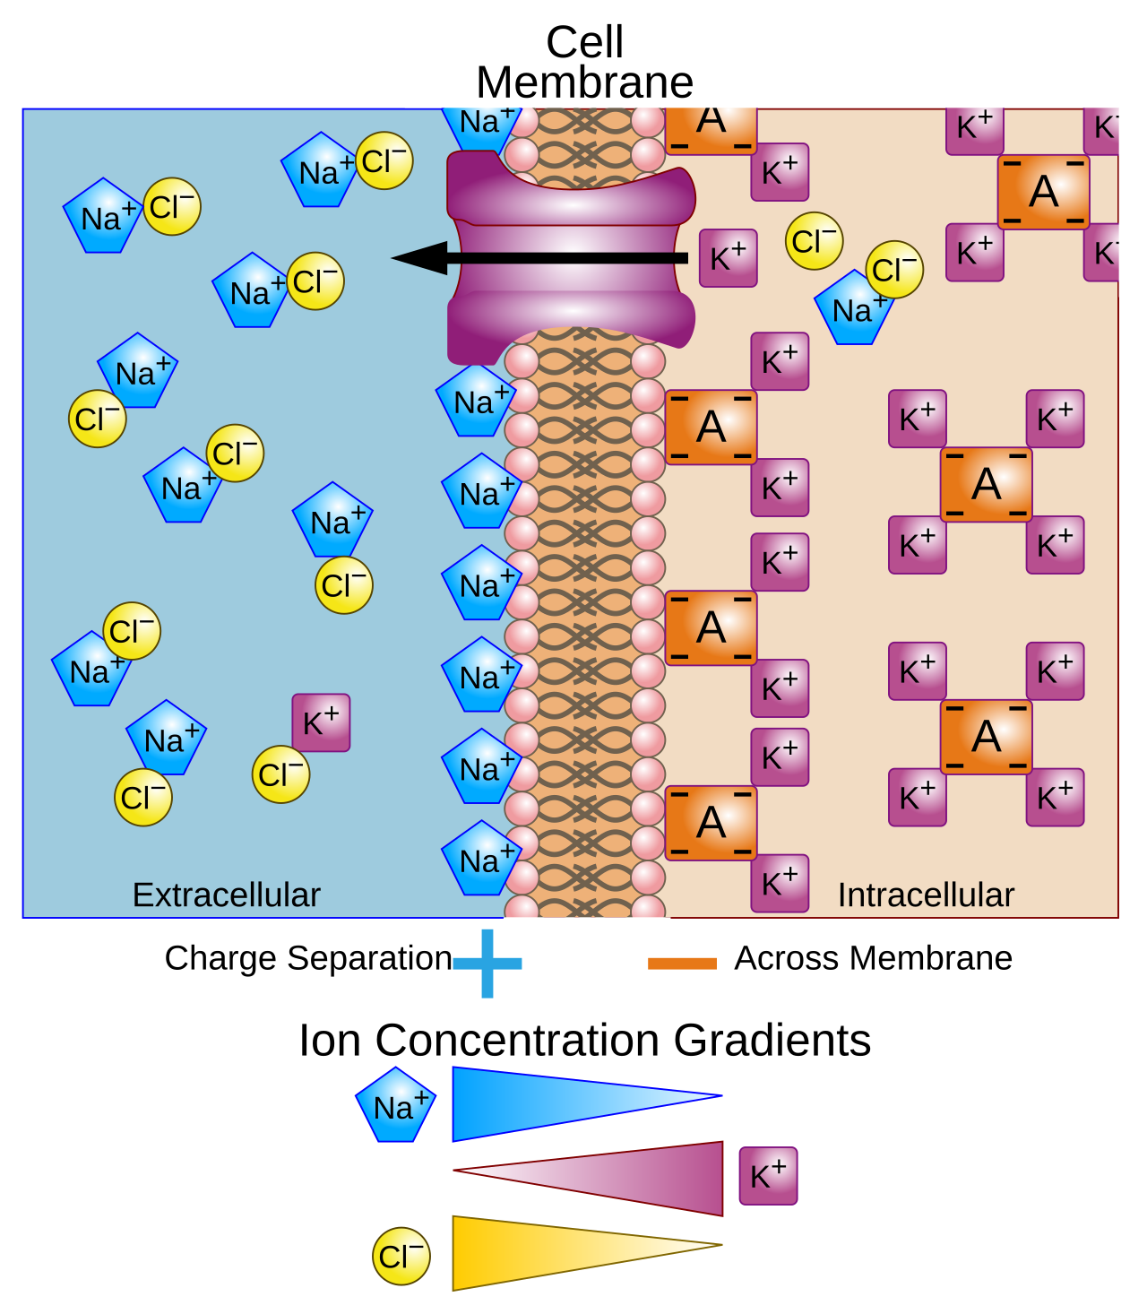
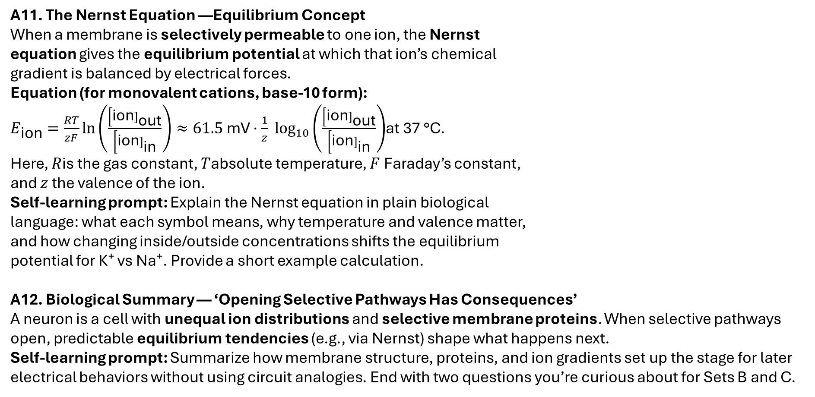
A11. The Nernst Equation —Equilibrium Concept When a membrane is selectively permeable to one ion, the Nernst
equation gives the equilibrium potential at which that ion’s chemical
gradient is balanced by electrical forces. Equation (for monovalent cations, base‑10 form): $E_{\text{ion}}=\frac{RT}{zF}ln⁡\left(\frac{\left[\text{ion}]_{\text{out}}\right.}{\left[\text{ion}]_{\text{in}}\right.}\right)≈61.5 \text{mV}⋅\frac{1}{z} {log⁡}_{10}\left(\frac{\left[\text{ion}]_{\text{out}}\right.}{\left[\text{ion}]_{\text{in}}\right.}\right)$at 37 °C. Here, $R$is the gas constant, $T$absolute temperature, $F$Faraday’s constant,
and $z$the valence of the ion.
Self‑learning prompt: Explain the Nernst equation in plain biological
language: what each symbol means, why temperature and valence matter,
and how changing inside/outside concentrations shifts the equilibrium
potential for K⁺ vs Na⁺. Provide a short example calculation.
A12. Biological Summary — ‘Opening Selective Pathways Has Consequences’
A neuron is a cell with unequal ion distributions and selective membrane proteins. When selective pathways open, predictable equilibrium tendencies (e.g., via Nernst) shape what happens next.
Self‑learning prompt: Summarize how membrane structure, proteins, and ion gradients set up the stage for later electrical behaviors without using circuit analogies. End with two questions you’re curious about for Sets B and C.

